Slide 1
Chapter 9
Factor Analysis and Inference
for Structured
Covariance Matrices

Slide 2
9.1 INTRODUCTION
Factor analysis has provoked rather turbulent con-troversy throughout its history. Its modern beginn-ings lie in the early 20th-century attempts of Karl Pearson, Charles Spearman, and others to define and measure intelligence.

Slide 3




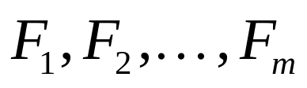
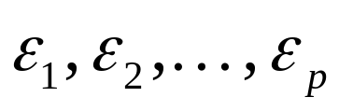
9.2 THE ORTHOGONAL
FACTOR MODEL
The observable random vector , with compon-ents, has mean and convariance matrix . The factor model postulates that is linearly depend-ent upon a few unobservable random variables
, called common factors, and additi-onal sources of variation , called errors or, sometimes, specific factors. In particular, the factor analysis model is

Slide 4
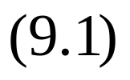

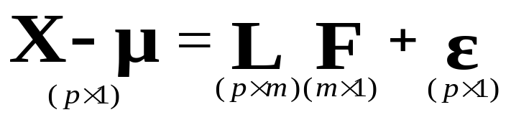
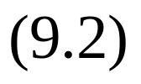

or, in matrix notation,
The coefficient is called the loading of the ith

Slide 5



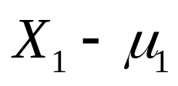
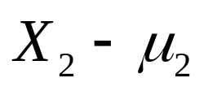
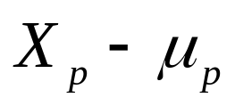


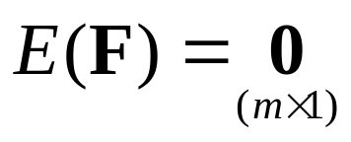
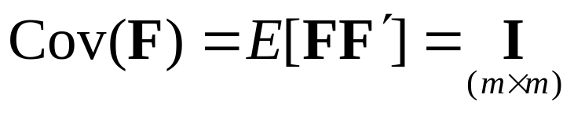
variable on the jth factor, so the matrix is the matrix of factor loadings. Note that the ith specif-ic factor is associated only with the ith respon-se . The deviations , , , are expressed in terms of random variables
, which are unobservable.
we assume that
,

Slide 6
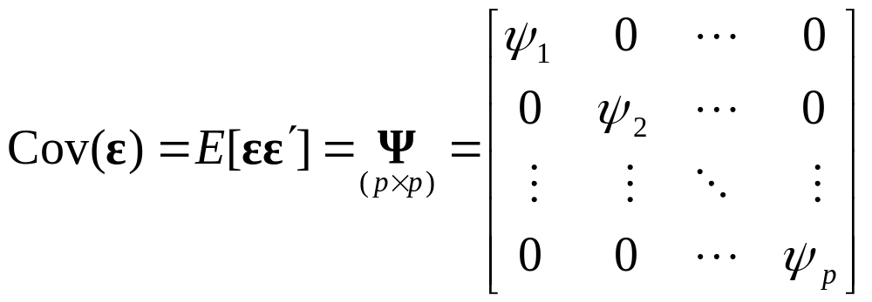
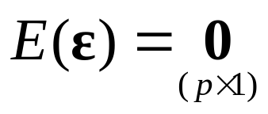
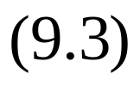


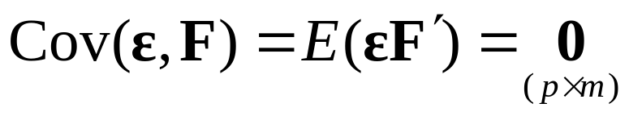
,
And that and are independent, so
These assumption and the relation in (9-2) constit-ute the orthogonal factor model.

Slide 7
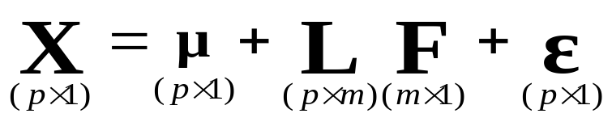
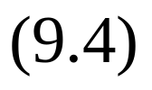
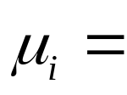
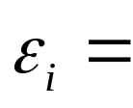
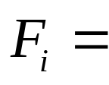
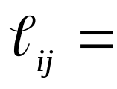
ORTHOGONAL FACTOR MODEL WITH m COMMON FACTORS
mean of variable i
ith specific factor
jth common factor
loading of the ith variable on the jth factor
The unobservable random vectors and satisfy

Slide 8
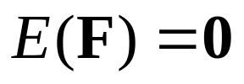
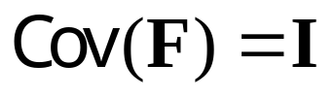
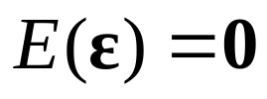
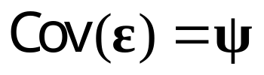

the following conditions:
and are independent
,
, , where is a diagonal matrix

Slide 9
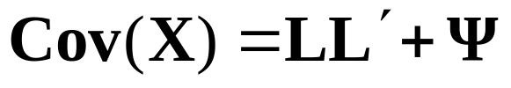
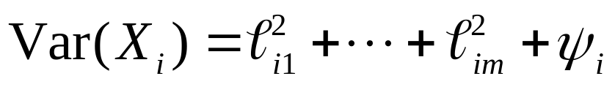
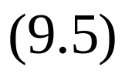
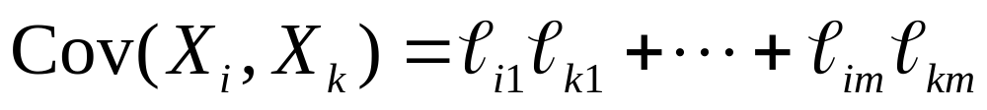
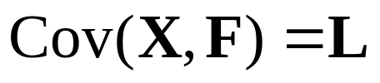
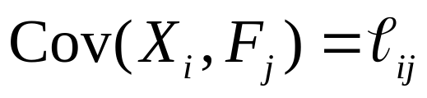
COVARIANCE STRUCTURE FOR THE ORT-HOGONAL FACTOR MODEL
1.
or
2.
or

Slide 10
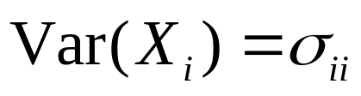

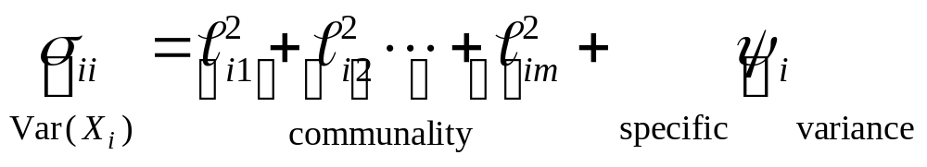


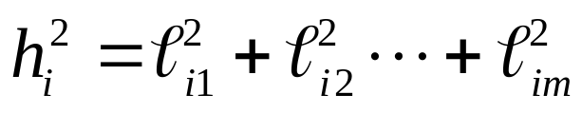
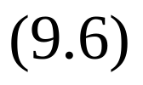
That portion of the variance of the ith variable contributed by the m common factors is called the ith communality. That portion of due to the specific factor is often called the uniqueness, or specific variance. Denoting the ith communali-ty by , we see from (9.5) that
or

Slide 11
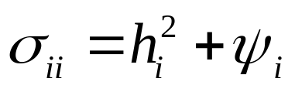
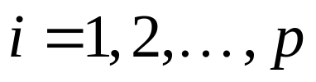
and
,
The ith communality is the sum of squares of the loading of the ith variable on the m common fact-ors.

Slide 12

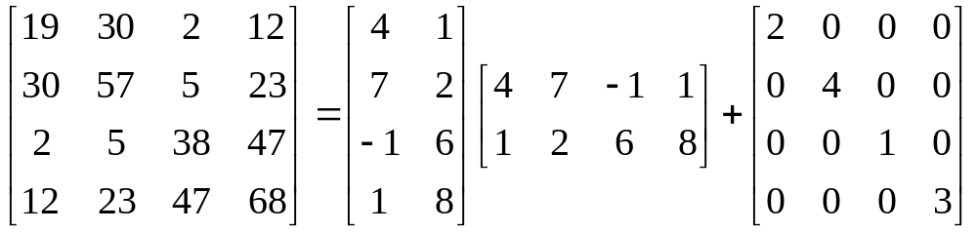
Example 9.1 (Verifying the relation for two
factors)
P.480
The equality
A similar breakdown occurs for the other variables.

Slide 13
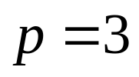

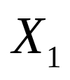
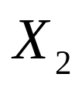
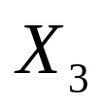
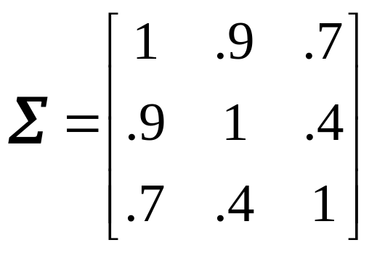
Example 9.2 (Nonexistence of a proper solution)
P.482
Let and , and suppose the random variables , , and have the positive defin-ite covariance matrix

Slide 14
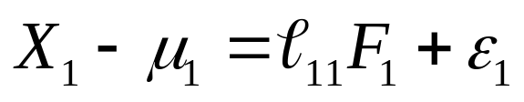
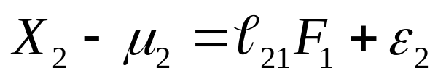

Using the factor model in (9-4), we obtain
The covariance structure in (9.5) implies that
or

Slide 15
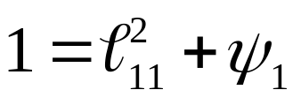
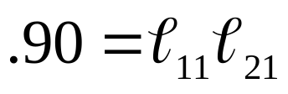
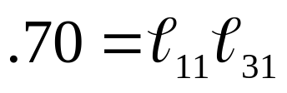
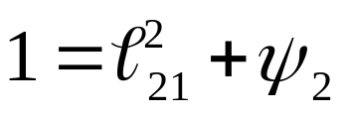
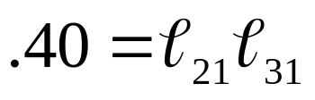
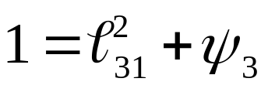

The pair of equations
implies that

Slide 16







Substituting this result for in the equation
yields , or . Since (by assumption) and ,
. Now, a correlation coefficient can-not be greater than unity (in absolute value).

Slide 17




9.3 METHODS OF ESTIMATION
The Principal Component (and Principal Factor) Method
The spectral decomposition of (2-20) provides us with one factoring of the covariance matrix . Let
have eigenvalue-eigenvector pairs with
. Then

Slide 18





This fits the prescribed covariance structure for the factor analysis model having as many factors as variables and specific variance for all i. The loading matrix has jth column given by .

Slide 19




Apart from the scale factor , the factor loadings on the jth factor are the coefficients for the jth principal component of the population.
The ith common factor is

Slide 20




since the eigenvector has unit length. In general,
Proportion of total for a factor analysis of S
sample variance =
due to jth factor for a factor analysis of R

Slide 21

Example 9.3 (Factor analysis of consumer-preference data) P.487
In a consumer-preference study, a random sample of customers we-re asked to rate several attributes of a new product. The correlation matrix is presented next:
Attribute (Variable) 1 2 3 4 5
Taste 1
Good buy for money 2
Flavor 3
Suitable for snack 4
Provides lots of energy 5
.96
.85
.79

Slide 22



It is clear from the circled entries in the correlat-ion matrix that variables 1 and 3 and variables 2 and 5 from groups. Variable 4 is “closer” to the (2,5)group than the (1,3) group. We might expect that the apparent linear relationships between the variables can be explained in terms of, at most, two or three common factors.
The first two eigenvalues, and , of R are the only eigenvalues greater than unity. Moreover, common factors will account for a cumulative proportion

Slide 23

of the total (standardized) sample variance. The estimated factor loadings, communalities, and spe-cific variance, obtained using (9.15), (9-16), and (9.17), are given in table 9.1.

Slide 24
Example 9.4 (Factor analysis of stock-price data) P.489

Slide 25




A Modified Approach - the Principal Factor Solut-ion
If the factor model is correctly specifi-ed, the m common factors should account for the off-diagonal elements of , as well as the commu-nality portions of the diagonal elements
If the specific factor contribution is removed from the diagonal or, equivalently, the 1 replaced

Slide 26



by , the resulting matrix is .
We obtain a “reduced” sample correlation matrix

Slide 27




The Maximum Likelihood Method
If the common factors and the specific factors can be assumed to be normally distributed, then maximum likelihood estimates of the factor loadi-ngs and specific variances may be obtained. When
and are jointly normal, the observations
are then normal, and from (4.16), the likelihood is

Slide 28

which depends on and through .

Slide 29
Example 9.5 (Factor analysis of stock-price data using the maximum likelihood method) P.493

Slide 30
Example 9.6 (Factor analysis of Olympic decath-lon data) P.495

Slide 31
9.4 FACTOR ROTATION
As we indicated in Section 9.2, all factor loadings obtained from the initial loadings by an orthogonal transformation have the same ability to reproduce the covariance (or correlation) matrix. [See (9.8). ] From matrix algebra, we know that an orthogonal transformation corresponds to a rigid rotation (or reflection) of the coordinate axes. For this reason, an orthogonal transformation of the factor loadings, as well as the implied orthogonal transformation

Slide 32






of the factors, is called factor rotation.
If is the matrix of estimated factor loa-dings obtained by any method (principal compon-ent, maximum likelihood, and so forth) then
, where (9.42)
is a matrix of “rotation” loadings. Moreover, the estimated covariance (or correlation) matrix re-mains unchanged, since
(9.43)

Slide 33











Equation (9.43) indicates that the residual matrix,
, remains unchanged,
where .
The coordinate axes can then be visually rota-ted through an angle-call it -and the new rotated loadings are determined from the relationships
(9.44)

Slide 34

clockwise
rotation
where
counterclockwise
rotation

Slide 35
Example 9.8 (A first look at factor rotation) P.502

Slide 36
Example 9.9 (Rotated loadings for the consumer-preference data) P.505

Slide 37
Example 9.10 (Rotated loadings for the stock-price data) P.507

Slide 38
Example 9.11 (Rotated loadings for the Olympic decathlon data) P.508

Slide 39



Oblique Rotateions
Orthogonal rotations are appropriate for a factor model in which the common factors are assumed to be independent.
If we regard the m common factors as coordin-ate axes, the point with the m coordinates
represents the position of the ith variable in the factor space. Assuming that the variables are grouped into nonoverlapping clusters, an orthogonal rotation to a simple structure

Slide 40
corresponds to a rigid rotation of the coordinate axes such that the axes, after rotation, pass as closely to the clusters as possible. An oblique rotation to
a simple structure corresponds to a nonrigid rotat-ion of the coordinate system such that the rotated axes (no longer perpendicular) pass (nearly) thro-ugh the clusters. An oblique rotation seeks to exp-ress each variable in terms of a minimum number of factors-preferably, a single factor.

Slide 41



9.5 FACTOR SCORES
In factor analysis, interest is usually centered on the parameters in the factor model. However, the estimated values of the common factors, called fa-ctor scores, may also be required. These quantities are often used for diagnostic purposes, as well as inputs to a subsequent analysis.
Factor scores are not estimates of unknown pa-rameters in the usual sense. Rather, they are esti-mates of values for the unobserved random factor vectors , . That is, factor scores
estimate of the values attained by (jth case)

Slide 42



The estimation situation is complicated by the fact that the unobserved quantities and outnumber the observed .
Both of the factor score approaches have two elements in common:
1. They treat the estimated factor loadings and specific variances as if they were the true valu-es.
2. They involve linear transformations of the orig-inal data, perhaps centered or standardized.

Slide 43
Typically, the estimated rotated loadings, rath-er than the original estimated loadings, are used to compute factor scores.

Slide 44



The Weighted Least Squares Method
Bartlett has suggested that weighted least squares be used to estimate the common factor values.
The sum of the squares of the errors, weighted by the reciprocal of their variances, is

Slide 45






The solution (see Exercise 7.3) is
The factor scores generated by (9.50) have sample mean vector 0 and zero sample covariances. (See Exercise 9.16).
If rotated loadings are used in place of the original loadings in (9.50), the subsequent fac-tor scores, , are related to by ,
.

Slide 46




Comment. If the factor loadings are estimated by the principal component method, it is customary to generate factor scores using an unweighted (or-dinary) least squares procedure. Implicitly, this amounts to assuming that the are equal or near-ly equal. The factor scores are then

